Slide 1
Physiological signal introduction and processing
Dr Zhiqiang Zhang
School of Electronic and Electrical Engineering
School of Mechanical Engineering
Faculty of Engineering and Physical Sciences
Email: z.zhang3@leeds.ac.uk
Room: EEE 1.69

Slide 2
Excitable cells are the sources of bioelectric potentials
electrochemical activity of a certain class of cells
components of nervous, muscular, & glandular tissue
Recordings of bioelectric phenomena
electrocardiogram (ECG)
electroencephalogram (EEG)
electromyogram (EMG)

Slide 3
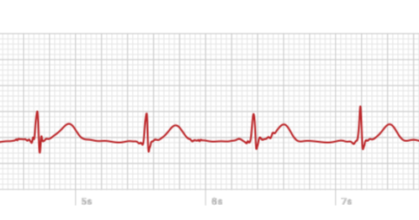
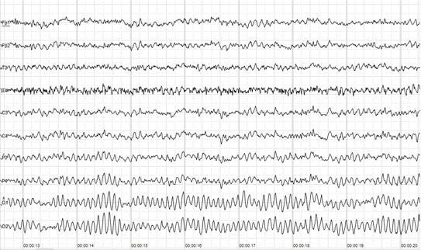
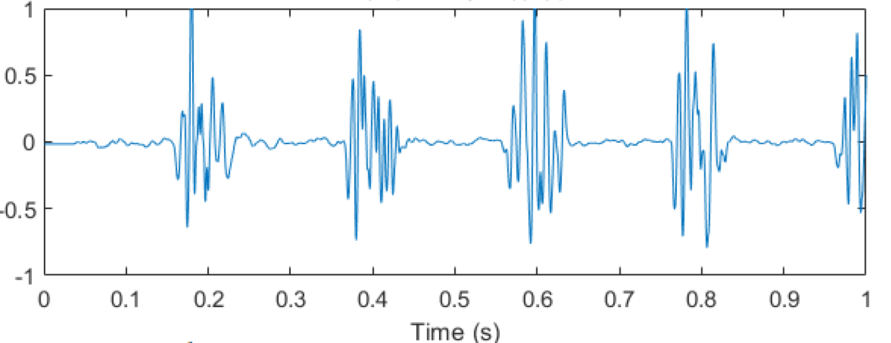
Typical physiological signals

Slide 4
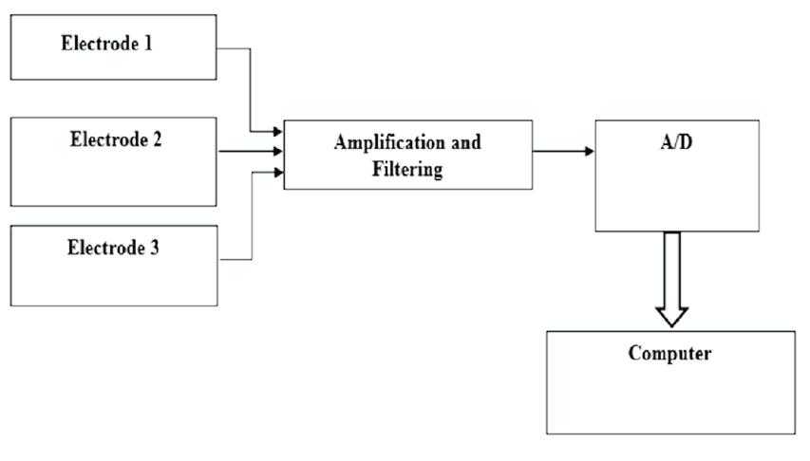
Physiological signals acquisition

Slide 5
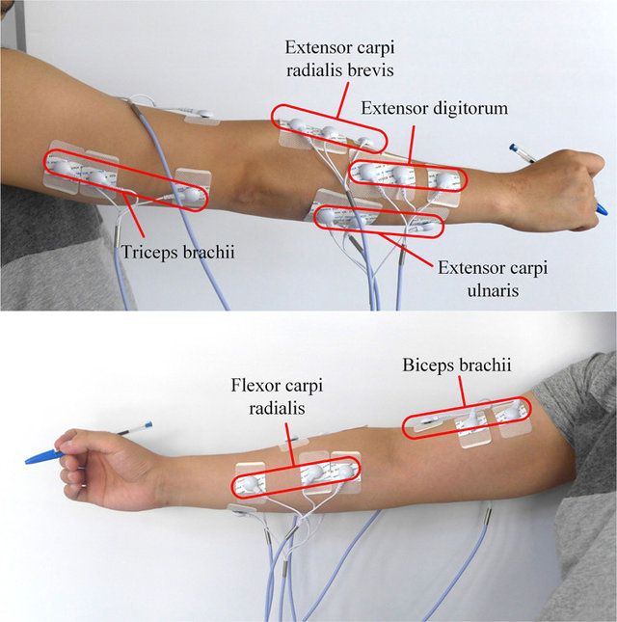
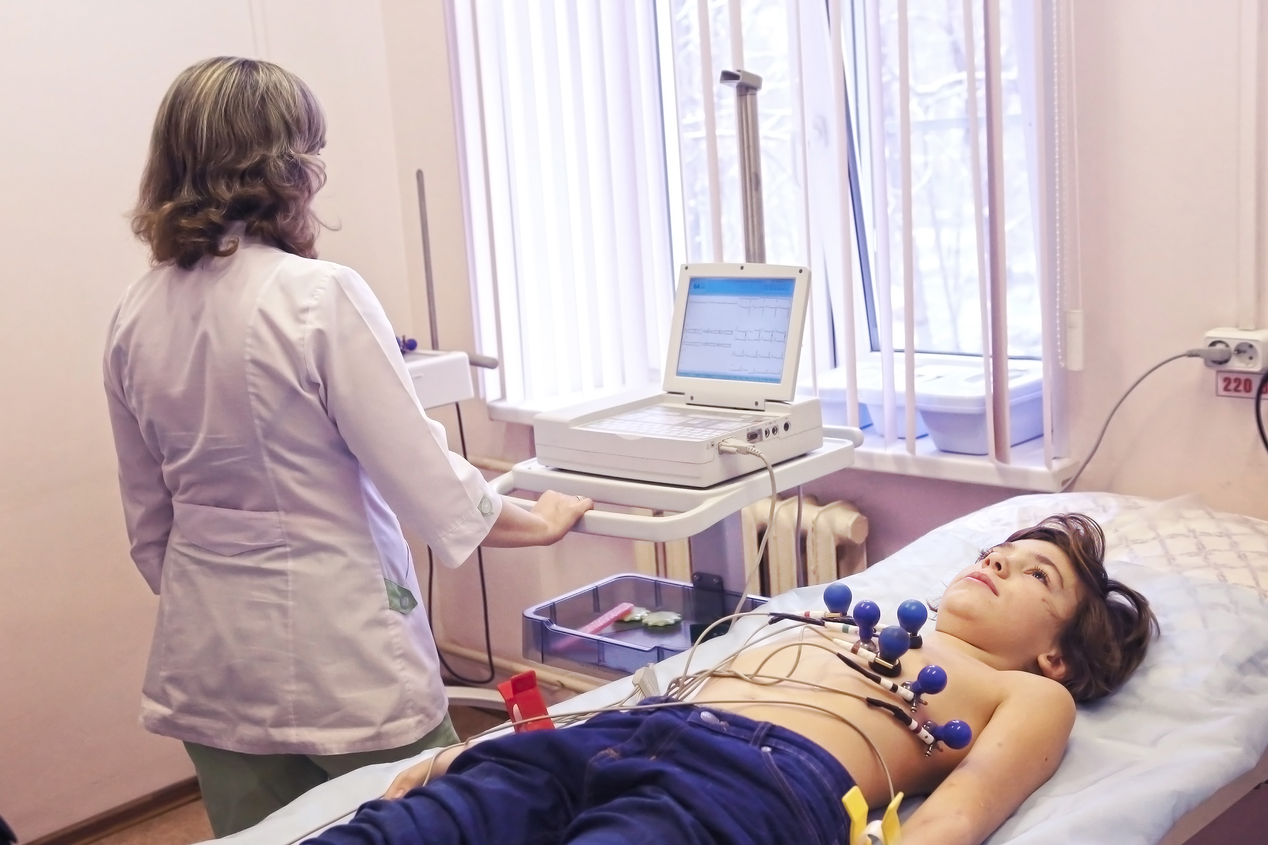
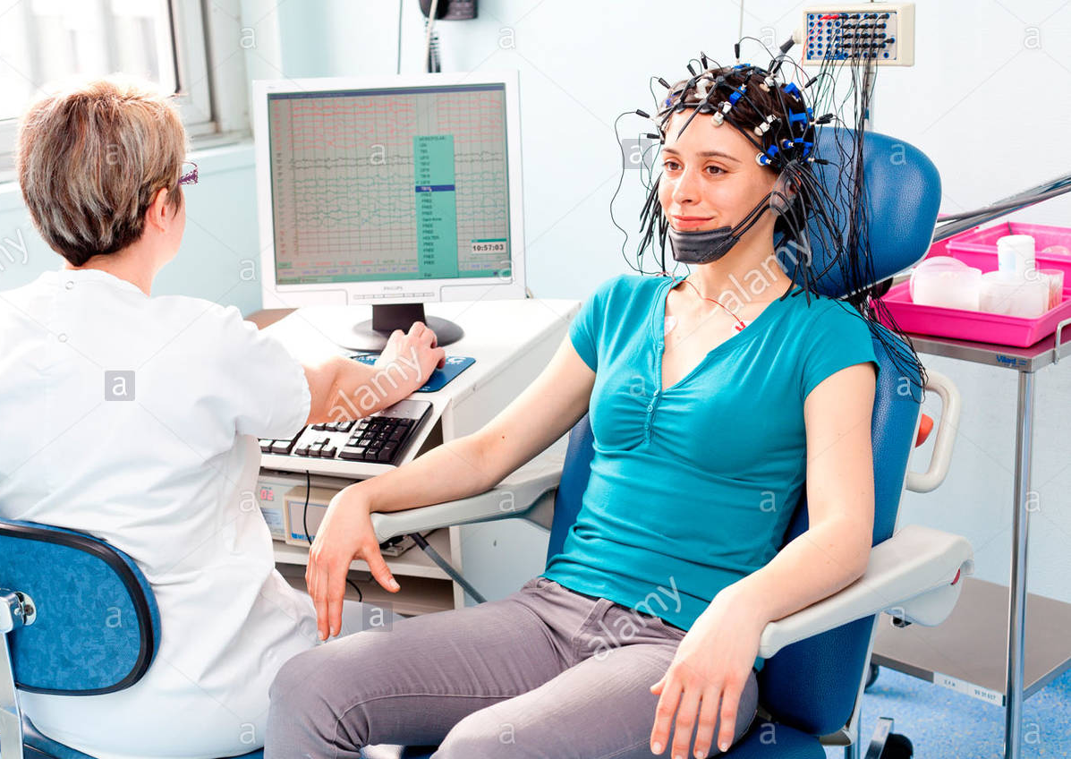
Traditional setup

Slide 6
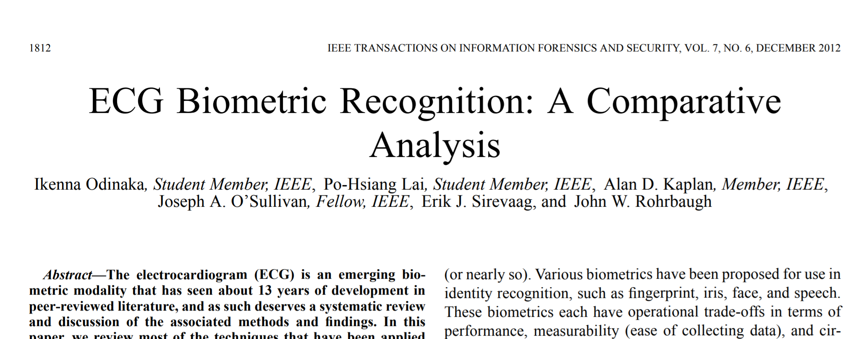


Applications: ECG

Slide 7
Applications: EMG
EMG is a diagnostic procedure to assess the health of muscles and the nerve cells that control them (motor neurons). EMG results can reveal nerve dysfunction, muscle dysfunction or problems with nerve-to-muscle signal transmission.

Slide 8

EEG application
https://www.nhs.uk/conditions/electroencephalogram/

Slide 9
Mind control wheelchair https://www.youtube.com/watch?v=1VPY1d2t_FE
SSVEP speller https://www.youtube.com/watch?v=KCW57QDNDos

Slide 10
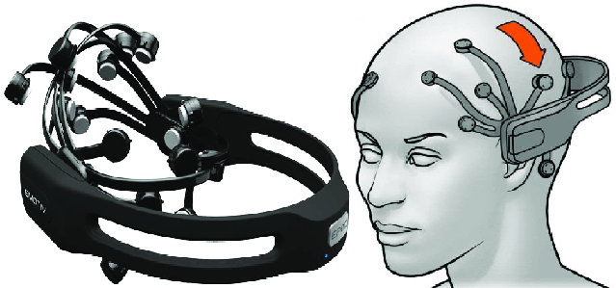
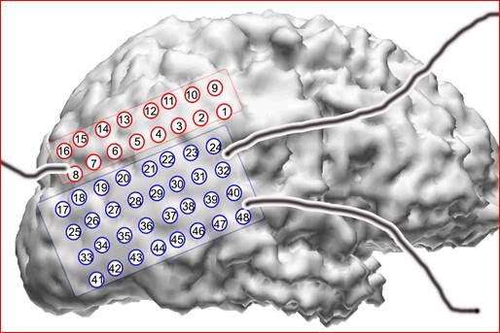
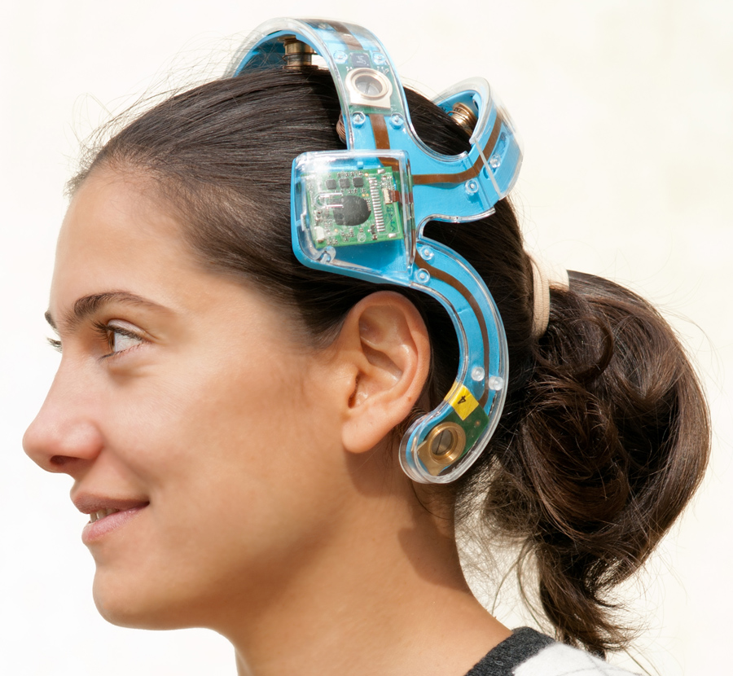
Portable system: EEG

Slide 11
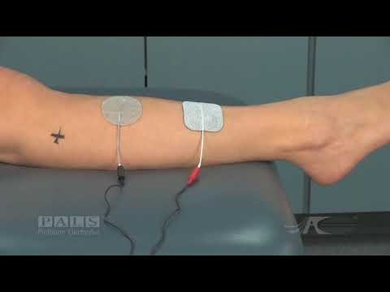
Active intervention: movement
How can we use the muscle electrical signal the other way around
Effect pathway is blocked
Muscle can’t contract by itself
https://www.youtube.com/watch?v=v_3NqHcuxjo

Slide 12

Active intervention: pain management

Slide 13
EMG signal processing

Slide 14
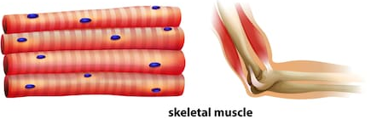
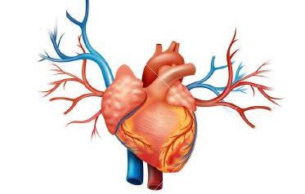
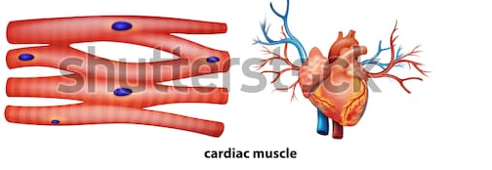
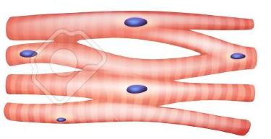
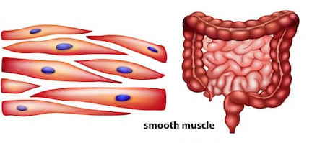
Three types of muscle
Skeletal muscle
Cardiac muscle
Smooth muscle
Notes:
digestive tract,
Respiration tract
Blood vessel :Flow of blood, Walls of blood vessels
Bladder: Push out Urine
Uterus: push the baby out
Walls of stomach
Intestines (/ɪnˈtɛstɪn/)

Slide 15
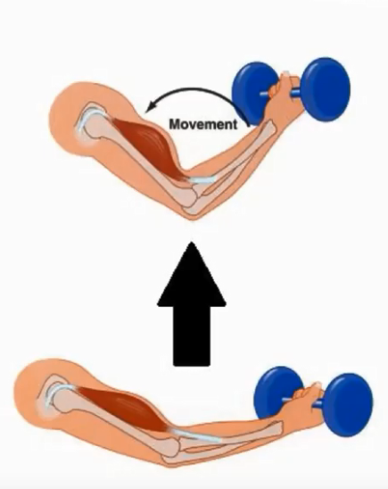
Functional Characteristics
Contractility
Notes:
Shorter and thicker

Slide 16
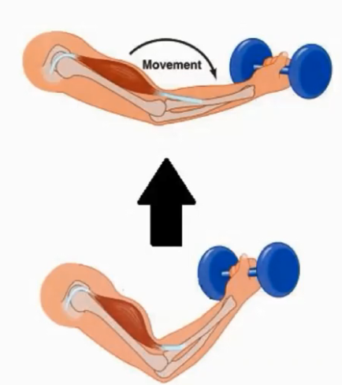
Functional Characteristics
Contractility
Extensibility
Notes:
Stretched, thinner and longer

Slide 17
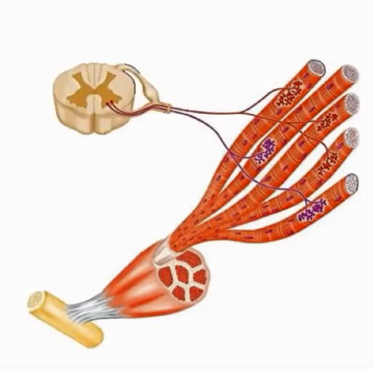
Functional Characteristics
Contractility
Extensibility
Excitability
Notes:
Ability to receive and respond to a stimuli

Slide 18
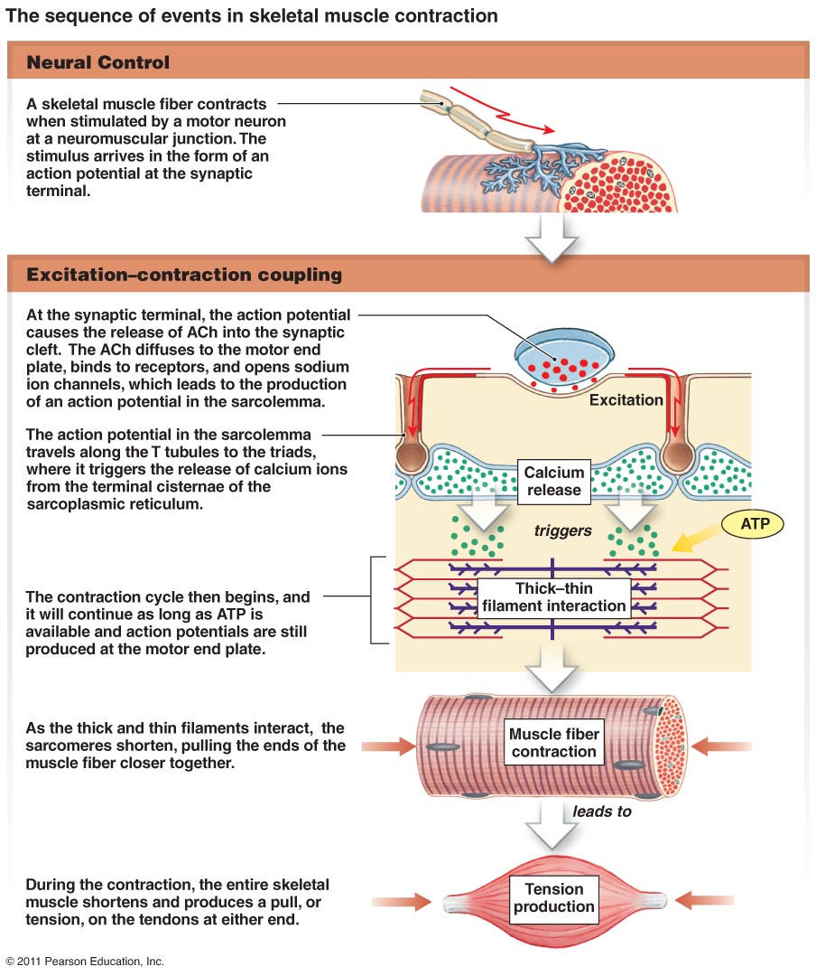
Sequence in skeletal muscle contraction

Slide 19
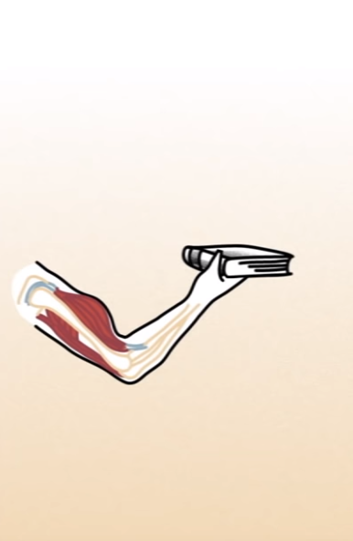
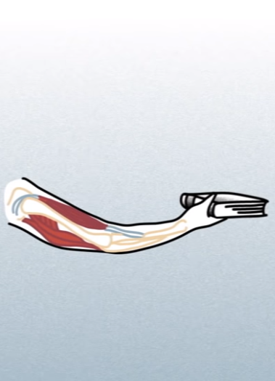
Elbow Flexion/Extension

Slide 20
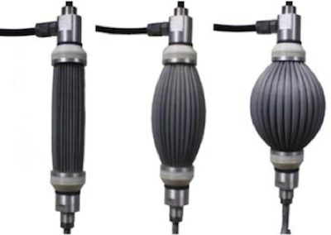
Artificial muscle

Slide 21
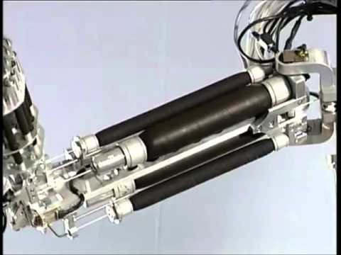
Festo Air Arm

Slide 22

Interactive Experiments
Hold your arm, and find out how long you can hold it?
Hold your arm with an object, and find out how will it affect your performance?
Hold your arm with different object (weight varies). What would happen you to arm? Share your experience

Slide 23
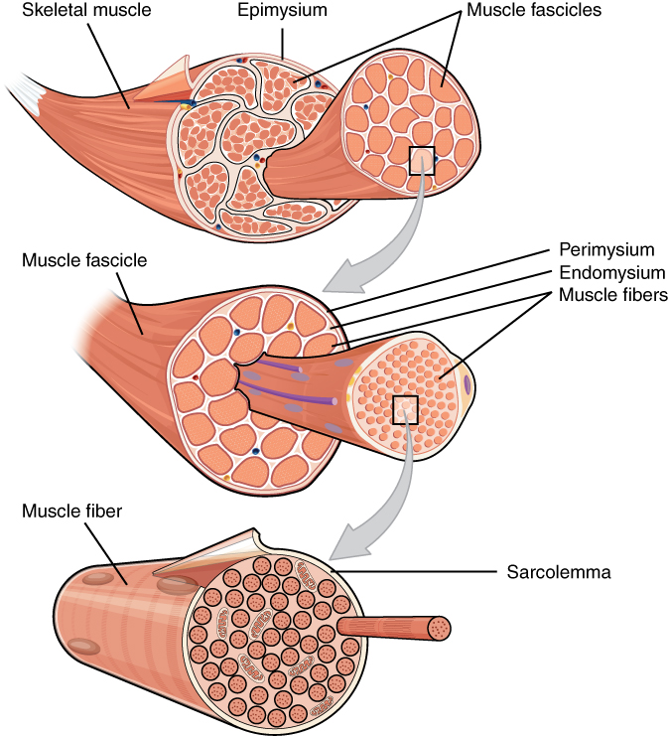

Slide 24
EMG basic
Motor unit
The smallest functional unit to describe the neural control of the muscular contraction process
The motor neuron, situated in the spinal cord, has a long axon which goes to the muscle.
Each axon splits up into a number of branches each of which ends on a motor endplate on a muscle fibre.
Ensemble of a motor neuron and the muscle fibres it innervates is called the motor unit.

Slide 25
EMG basic
Motor Unit Action Potential
Typically, each motor-neuron innervates several hundred muscle fibers (innervation ratio)
Motor Unit Action Potential (MUAP) = summed electrical activity of all muscle fibers activated within the motor unit
Muscle force increased through higher recruitment and increased rate coding

Slide 27
EMG signals acquisition

Slide 28
Types of EMG electrodes
Inserted
Fine-wire (Intra Musular)
Needle
Implanted

Slide 29
Types of EMG electrodes
Inserted
Fine-wire (Intra Musular)
Needle
Implanted
Surface
Extramuscular

Slide 30
Which one do you prefer??
https://www.youtube.com/watch?v=R1HVGGzz2u0
https://www.youtube.com/watch?v=fr3bDpzeKkQ
https://www.youtube.com/watch?v=gHsZ0bwxMsg&t=224s
https://www.youtube.com/watch?v=Z3uE4bRSkMc

Slide 31
Fine-wire/Needle Electrodes
Advantages
Extremely sensitive
Record the activity of a single motor unit
Access to deep musculature
Little cross-talk concern
Disadvantages
Requires medical personnel, certification
Repositioning nearly impossible
Detection area may not be representative of entire muscle

Slide 32
Surface Electrodes
Advantages
Quick, easy to apply
No medical supervision, nor required certification
Minimal discomfort
Easy to reposition
Disposable
Disadvantages
Generally used only for superficial muscles
Cross-talk concerns
No standard electrode placement
May affect movement patterns of subject
The most common and widely used in practice

Slide 33
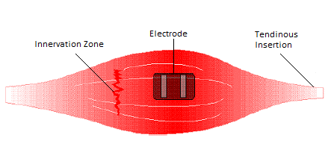
Surface electrode placement
The surface EMG electrodes should be placed
between the motor unit and the tendinous insertion of the muscle,
along the longitudinal midline of the muscle
Electrode alignment with the direction of muscle fibres to increase probability of detecting same signal

Slide 34
When the electrodes are arranged in this way, the detecting surfaces intersect most of the same muscle fibres, and as a result, an improved superimposed signal is observed.

